Slide 1
From ER Diagram to Relational Schema
CSE 215 (Database)
Ref: Korth (Chapter 7.6)
Md. Saiful Islam
Lecturer
Department of CSE, BUET

Slide 2
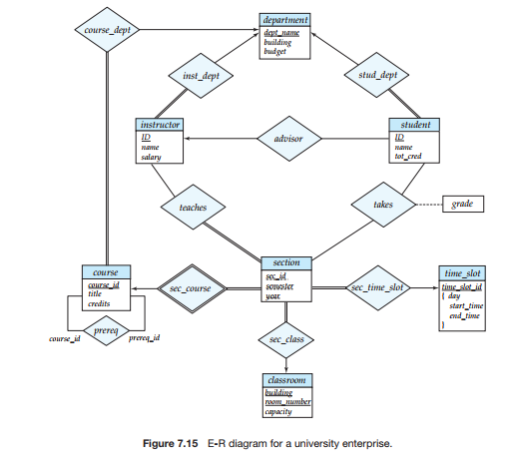
ERD

Slide 3
Relational Schema
Please carefully follow the lecture and take notes.
Class lecture notes will be uploaded in Moodle later.

